Slide 1
Machine Learning 101
Session 5 – SVM part 1

Slide 2
Agenda
Recap Session 4
Key takeaway for this session
What is SVM?
Example

Slide 3
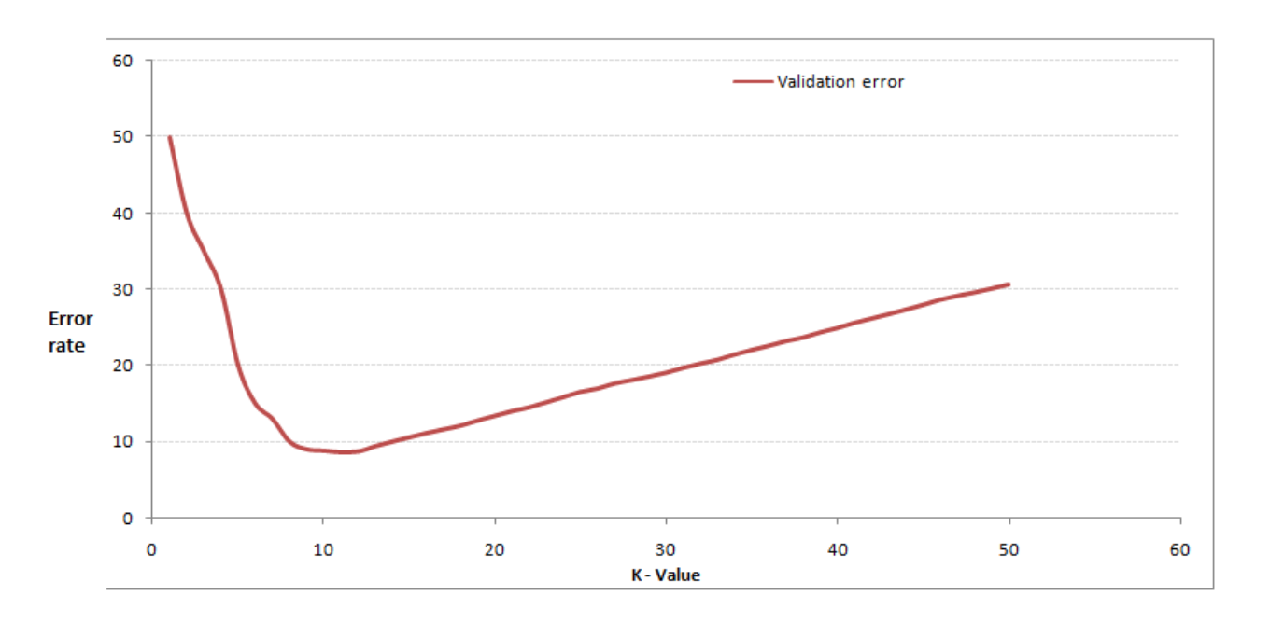
Recap Session 4 - A
What is KNN?
True or False: k-NN algorithm does more computation on test time rather than train time.
In the image below, which would be the best value for k assuming that the algorithm you are using is k-Nearest Neighbor.

Slide 4
Recap of Session 4 - B
Which of the following options is true about k-NN algorithm?
A) It can be used for classification B) It can be used for regression C) It can be used in both classification and regression
Which of the following statements is true for k-NN classifiers?
A) The classification accuracy is better with larger values of k B) The decision boundary is smoother with smaller values of k C) The decision boundary is linear D) k-NN does not require an explicit training step

Slide 5
Key Takeaway
What does SVM stand for?
What is Margin?
How to use SVM to identify Iris dataset?

Slide 6
What is SVM - Background
SVM – Support Vector Machine
The original version of SVM was introduced by Vapnik, VN and Chervonenkis (Moscow, Russia) in 1963 - in the framework of the “Generalised Portrait Method” for computer learning and pattern recognition.
Current version of SVM is Soft Margin which was given by Vapnik et al. 1995 (Hard margin given by Boser et al. 1992)
Before Deep Learning be introduced in 2012, SVM model was one of the best performed Machine Learning model
Can you still remember the general process of Machine Learning?

Slide 7
What is SVM - Margin
What is Margin?
What does SVM mean?
Which line (H) is the best one?
H₁ does not separate the classes.
H₂ does, but only with a small margin.
H₃ separates them with the maximal margin.

Slide 8
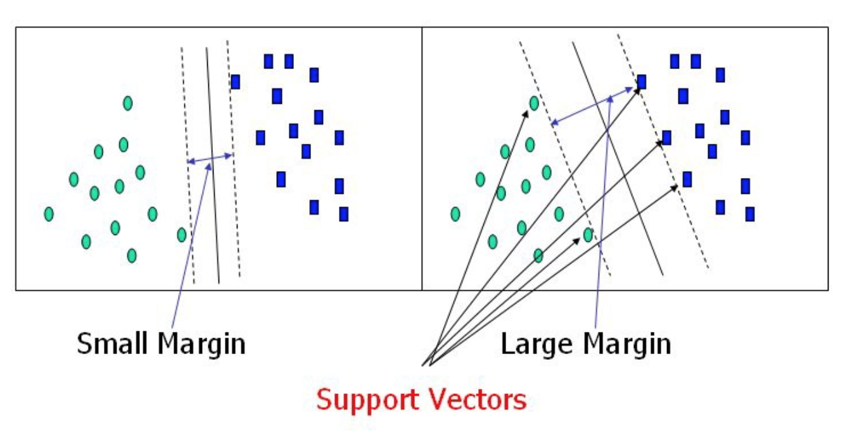
What is SVM - SVM
SVM – is to find a way (hyperplane) to have the maximum value of margin
Max Margin Hyperplane (MMH)

Slide 9
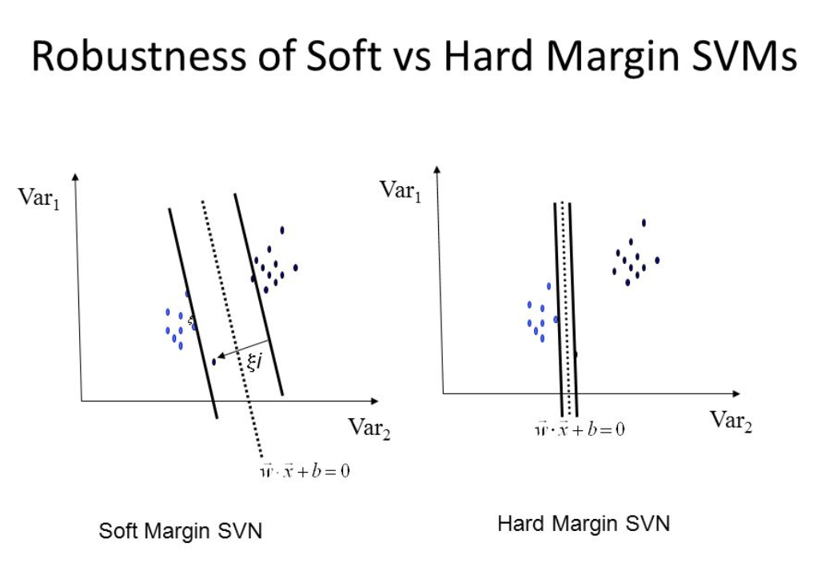
What is SVM – Soft vs Hard Margin
Soft margin is extended version of hard margin SVM.
Hard margin SVM can work only when data is completely linearly separable without any errors (noise or outliers).

Slide 10
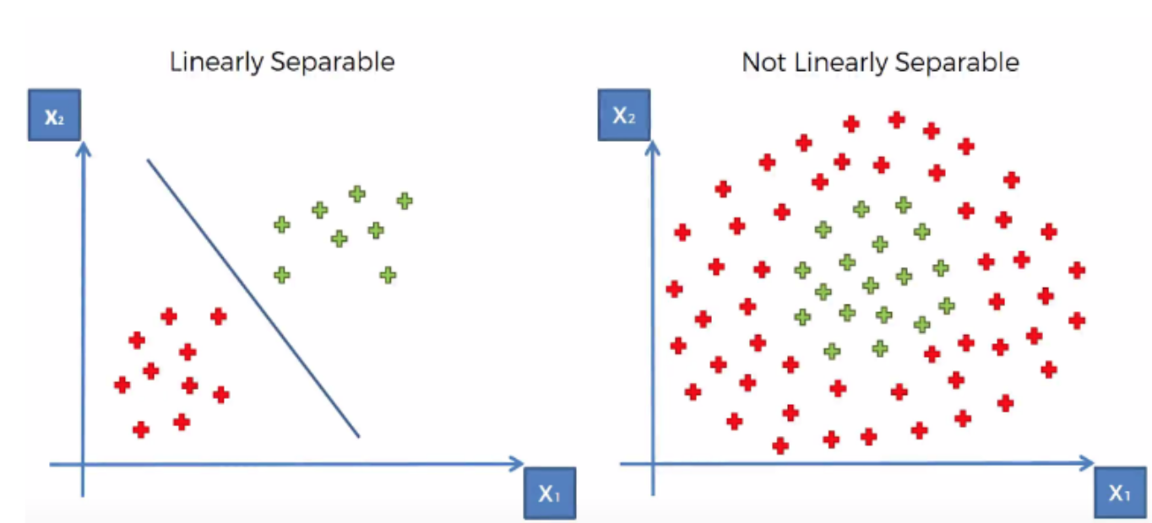
What is SVM – Linearly Separable vs Not Linearly Separable

Slide 11
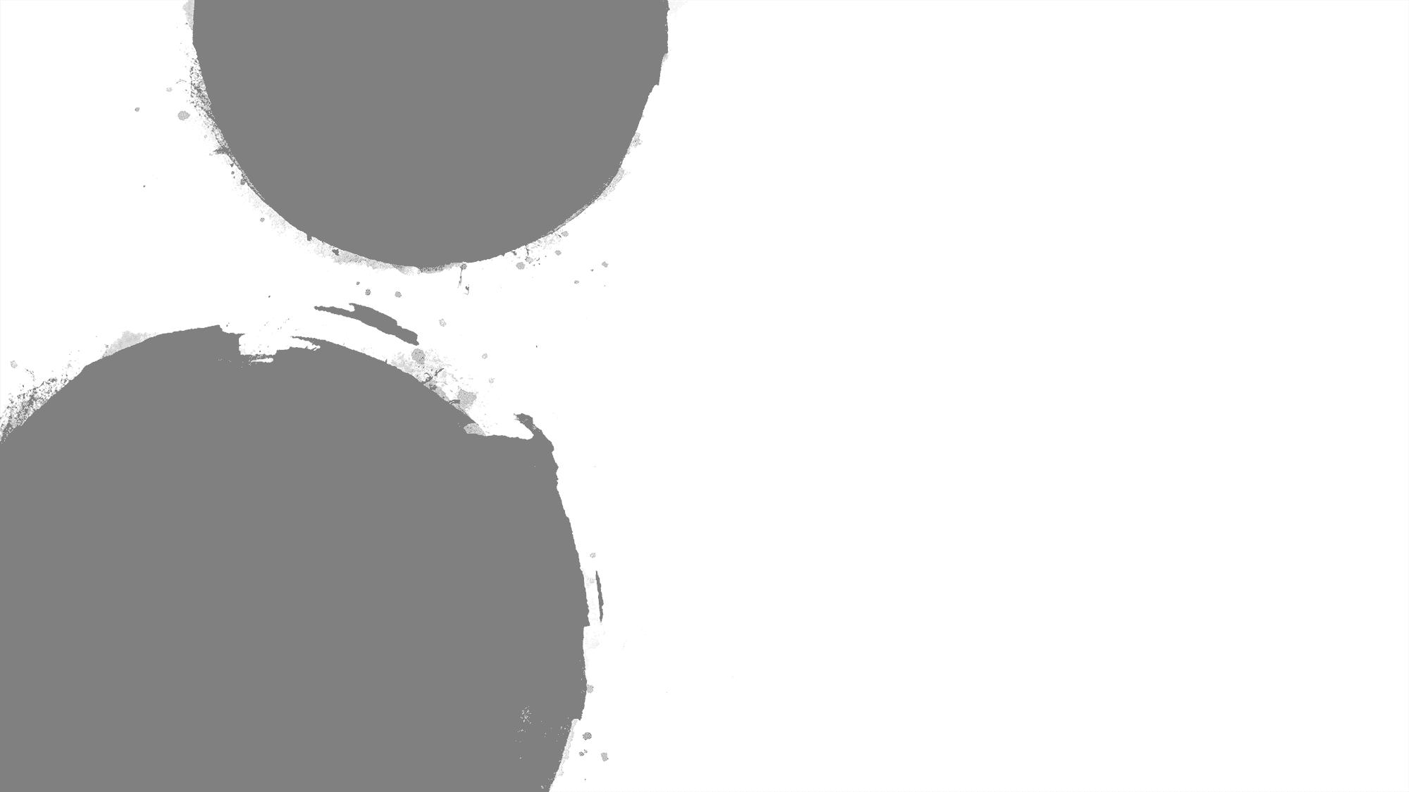
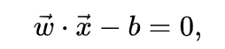
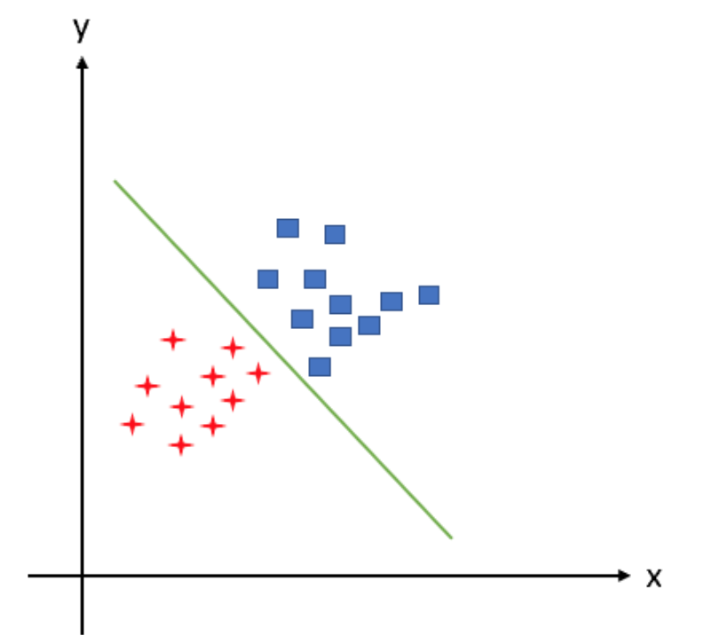
What is SVM - Definition
How to define the hyperplane mathematically?
W – Weighted vectors (w1, w2, w3, ….wn)
X – independent variables
b – bias
If I have 2 independent variables x1 and x2 , then we could write the hyperplane like below:
W1*X1 + W2*X2 + W0 = 0

Slide 12
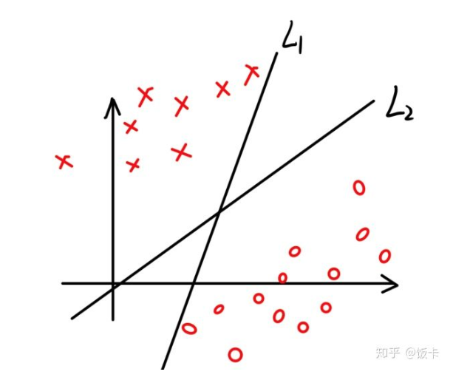
What is SVM - MMH
How to get Max Margin Hyperplane?
In order to get MMH, we need to adjust w value.
Assume, we have 2 different outputs – green and blue. In this case, we will need 2 hypothesis:
H0: Green (label -1)
w*xi –b < 0 -> yi =-1
H2: Blue (label 1)
w*xi –b >0 -> yi =1
Combined H0 & H1:
yi * (w*xi + b) >0

Slide 13
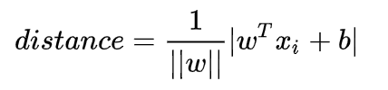
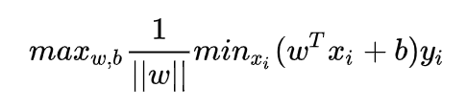
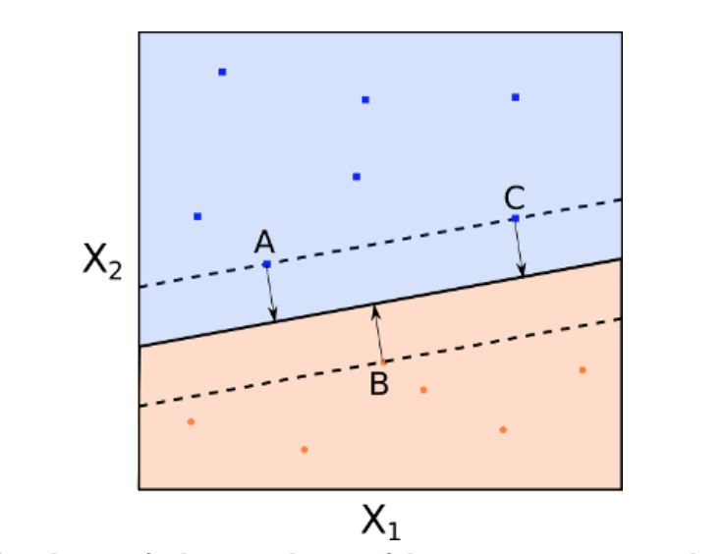
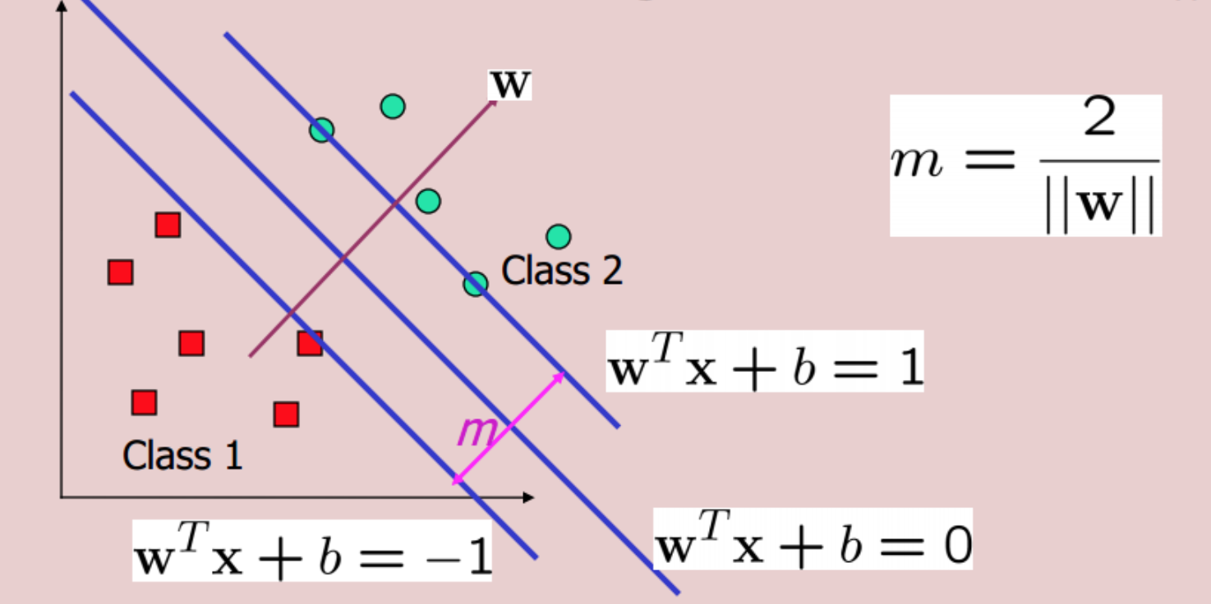
What is SVM – define W

Slide 14
Example
Iris dataset

